Slide 1
COMMUNICATION
    “Nothing in life is more important than the ability to communicate effectively.”
    Gerald Ford

Slide 2
Definition
Communication is the transfer and understanding of the intended meaning or message.

Slide 3
Functions of communication
Control member behaviour
  When X praises/ criticises Y, behaviour of Y could be affected
Motivate members
  When employees are clear about their job requirements, how well they’re doing, how they can improve performance, etc.
Releases emotional expression
  A way for members to show their frustrations and feelings of satisfaction
Information
  It provides information that facilitates decision making

Slide 4
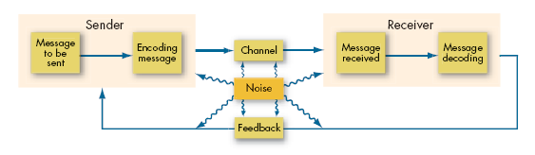
Communication process
  The steps between a source and a receiver that result in the transference and understanding of meaning

Slide 5


Communication Channels
Channel
  The medium selected by the sender through which the message travels to the receiver
Types of Channels
  Formal Channels
    Are established by the organization and transmit messages that are related to the professional activities of members
  Informal Channels
    Used to transmit personal or social messages in the organization. These informal channels are spontaneous and emerge as a response to individual choices

Slide 6
Direction of communication
Downward
  Higher to lower level
  Assign goals, give instructions, inform about policies, point out problems that need attention, offer feedback about performance
  Can be oral or face-to-face
  Mostly in the written form (e.g. memo, e-mail, etc.)‏

Slide 7
Direction of communication
Upwards
  Lower to higher level
  Used to provide feedback to higher ups
  Inform about progress/ problems
  Helps to keep managers informed about how employees feel about
    Their jobs
    Co-workers
    Organisation in general
  Examples of upward communication:
    Performance report prepared by lower level
    Suggestion boxes
    Employee attitude surveys
    Informal ‘gripe’ sessions

Slide 8
Direction of communication
Lateral / horizontal
  Communication between members of same group
  Why is lateral communication necessary?
    Saves time and facilitates coordination = Helps make faster decisions
  Lateral channels are mostly informal (sometime it may be formally sanctioned)
  Can be problematic when members bypass direct supervisor/ take decisions without informing supervisor

Slide 9
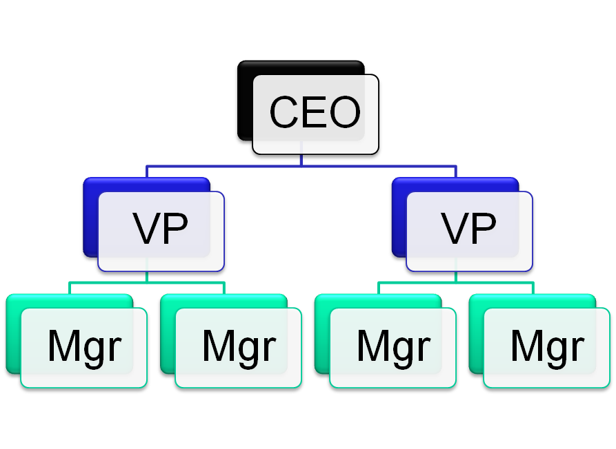
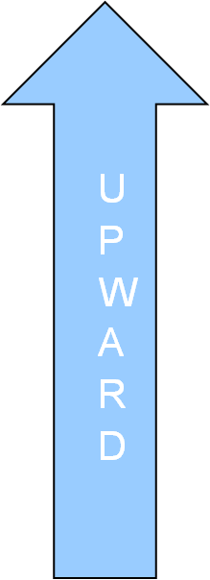

Direction of Communication
LATERAL

Slide 10
Interpersonal communication
Oral communication
  Most common way of communicating
  Popular forms of oral communication
    Speech, One-on-one, Group discussion, Face-to-face, Only audio, Informal rumour mill / Grapevine
  Advantage:
      Fast communication and feedback which allows immediate correction
      Strongest means for building relationships and trust (especially in face-to-face)‏
  Disadvantage:
      As the message passes from one member to another, there is every likelihood for distortion

Slide 11


Written communication
letters, memos, e-mail, periodicals, reports, notices
  Why write?
    tangible and verifiable
    important for complex and lengthy communication
    Can be used for ready reference (Annual plan)‏
    People are more careful about the written word than oral communication. (more logical, thought out and clear)‏
  Drawbacks:
    Time consuming
    Lack of feedback (no assurance of message being received and understood, as intended)‏
Email
Get out of your Chair!

Slide 12
Note written by Director to Joint Director
Tomorrow, at 12 noon, there will be a solar eclipse, something we do not see every day. Let the staff assemble wearing dark coloured clothes and sunglasses. I shall personally give the explanations to be made at the observation of this rare event. If it rains we shall not be able to see the eclipse very well. In that case we shall meet in the canteen. Tea and snacks will be provided out of this year’s Non-Plan expenditure.

Slide 13
Joint Director to Deputy Director
The Director has instructed that tomorrow at 12 A.M. there will be a solar eclipse. If it rains we in our sunglasses will miss it on the street. In that case the Director will make the disappearance take place in the canteen along with this year’s Non-Plan expenditure, something we do not see every day.

Slide 14
Deputy Director to Assistant Director
Upon instructions of the Director, the disappearance of the sun and this year’s Non-Plan expenditure will take place tomorrow at 12 in the canteen in sunglasses. The Director will also forecast whether it will rain; this is something we do not see everyday.

Slide 15
Assistant Director to Head Clerk
If it rains tomorrow in the canteen, something we do not see everyday, then the Director wearing dark glasses will disappear along with the money allocated for this year’s Plan expenditure at midnight.

Slide 16
Head Clerk to Office Assistant (U.D. and L.D.)‏
Tomorrow at midnight, the Director wearing only dark glasses and nothing else, will make the money allocated for Plan expenditure disappear at midnight.
What a pity this cannot be seen every day
The message content when it reaches its destination is very often different from the original

Slide 17
Non-verbal communication
Every time we give a message to someone, we are also imparting a non-verbal message
Non-verbal includes – body movements, intonations(emphasis given to words), facial expressions and physical distance between sender and receiver - a glance, a stare, a smile, a frown, a wink, a gesture with your hands, fingers, eyes....all convey meaning
  Help me! I'm lonely!
  Leave me alone, I'm depressed
  Lift one eyebrow for disbelief
  Shrug our shoulders for indifference
  Tap our fingers for impatience
  Slap our foreheads for forgetfulness
Body Language – can enhance the spoken word
      Complementing
      Reinforcing
      Emphasizing
      Substituting
Body Language / Gestures – can contradict the spoken word

Slide 18
Intonations : The way you say it!
Placement of emphasis
What it means
Why don’t I take you to dinner tonight?
I was going to take someone else.
Why don’t I take you to dinner tonight?
In stead of the guy you were going with
Why don’t I take you to dinner tonight?
I’m trying to find a reason why I shouldn’t take you.
Why don’t I take you to dinner tonight?
Do you have a problem with me?
Why don’t I take you to dinner tonight?
Instead of going on your own.
Why don’t I take you to dinner tonight?
Instead of lunch tomorrow.
Why don’t I take you to dinner tonight?
Not tomorrow night

Slide 19
In general, in all communication, always Strive for 6 things:
  Accuracy
  Relevance
  Brevity
  Structure
  Clarity
  Audience

Slide 20
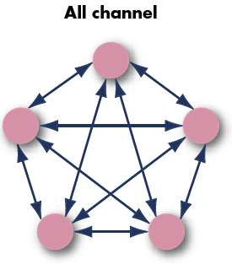
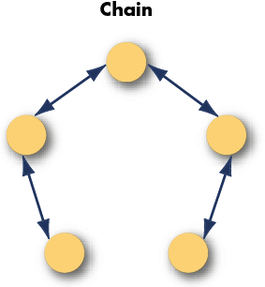
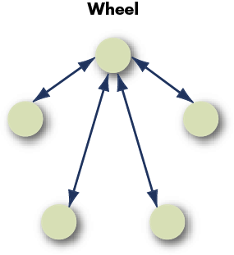
Organisational Communication
Formal small group networks
WHEEL:
Relies on central figure to act as conduit for all of the group’s communication
ALL CHANNEL:
Permits all group members to actively communicate with each other
All are free to contribute – no one takes a leadership role
CHAIN:
Follows formal chain of command
Formal Group Networks and their effectiveness
Criteria
Chain
Wheel
All Channel
Speed
Moderate
Fast
V Fast
Accuracy
High
V High
Moderate
No single network for all occasions
Emergence of leader
Moderate
High
None
Member satisfaction
Moderate
Low
High

Slide 21
The Grapevine
Informal communication channel
Very important source of information
  75% of employees hear about matters first through the grapevine and 75% of it is usually accurate
Main characteristics:
  Not controlled by management
  Perceived by most employees as more believable and reliable than formal communiqués
  Largely used to serve the self interest of the people within it
Research in a small firm among 67 managerial personnel
  Only 10% acted as liaison individual (i.e. pass out information to others)‏
  General information flowed between functional groups
  No evidence to suggest that one group always acted as the liaison
What starts a rumour mill/grapevine?
  Rumours emerge because the situations are important to us
  When there is ambiguity
  When the conditions are stressful/ anxious
  Only small number of cases is caused by gossip

Slide 22
The Grapevine
Conclusion?
  Grapevine is an important part of the organisation’s communication
  It gives managers a feel of the morale of others, identifies issues that are important
  Since only a small set (10%) normally act as liaisons, if management can identify these liaisons, it can help to explain and predict the pattern of the grapevine.

Slide 23
Barriers to effective communication
Filtering
  Sender purposely manipulate information so as to be seen favourably by the receiver
  The more vertical levels in hierarchy = more filtering
Why?
  Status difference
  Fear of conveying bad news
  Desire to please

Slide 24
Barriers to effective communication
Selective perception
  Receiver selectively process the information received
  Receives only what they want to hear /see
  Based on their needs, motivation, experience, background and other personal factors
  Receivers project their interests and expectations into communications as they decode them.
  We don’t see reality, we interpret what we see and call it reality

Slide 25
Barriers to effective communication
Information overload
  When information received exceeds our processing capacity
  Potential today for information overload is very high (e-mail, phone, instant messaging, meetings, updating one’s knowledge in the field, etc..)‏
Result:
  Select out
  Ignore
  Pass over
  Forget information
  postpone

Slide 26
Barriers to effective communication
Emotions
  How the receiver feels at the time of receipt of information influences how they will interpret it.
  Extreme emotions like jubilation or depression are likely to hinder effective communication
Result:
  We disregard our rational decision making and substitute it with emotional judgements

Slide 27
Barriers to effective communication
Language
  The language a person uses and the definitions he/she gives to words
  This differs depending on the age, education, gender, cultural background
  People develop their own ‘buzzwords’, terms that are unique to their area
  Existence of vertical levels can also cause language problems
  Senders and receivers have to assume that the words have the same meaning to both parties…which may not be true
  Bad, dog, excellent, not bad….

Slide 28
Barriers to effective communication
Communication apprehension
  About 5 – 20% of people suffer from a debilitating communication apprehension or anxiety
  Although many dread speaking in front of a group
  Communication apprehension is a more serious problem….because it affects the whole category of communication techniques
  People who suffer from CA have unnecessary anxieties and tension in written communication or oral presentations or both
  e.g. telephone conversations, face-to-face interactions
  Such individuals rely more on memos, faxes to convey information

Slide 29
Current issues in communication
Communication barriers between men and women (Deborah Tannen)‏
  Women speak and hear a language of connection and intimacy
  Men speak and hear a language of status, power and independence
  Men complain that women talk on and on about their problems – women criticise men for not listening
  Men are more direct than women in conversation
  Women tend to be less boastful than men….men misinterpret this as a lack of self confidence and competency

Slide 30
Current issues in communication
Silence as Communication
  The absence of speech or noise
  The dog that did not bark at night
  Silence can be a powerful tool of communication…
    It can signal agreement, dissent, frustration, anger, ignoring someone…
    The gaps, pauses, hesitations in communication may mean that the person is thinking, deciding how to frame an answer.
    Sometimes the real message in a communication is buried in the silence.

Slide 31
Current issues in communication
‘Politically correct’ Communication
  Words like blind, deaf, handicapped, old, have been replaced by ‘physically challenged’, visually impaired, differently abled, senior…
  Words can and do stereotype, intimidate and insult individuals. We must be sensitive to others' feelings.
  Downside: it can hinder and complicate our communication
  When we eliminate words from use because of political ‘incorrectness’, we limit our vocabulary
  Find your own proper balance

Slide 32
Current issues in communication
Cross cultural Communication
  A gesture accepted in one culture might be meaningless or lewd in another
  Barriers caused by semantics:
    Some words cannot be translated
  Barriers caused by word connotations:
    Same word implying different meaning in different languages
  Barriers caused by tone differences
    In some cultures the tone changes depending on whether the person is at home, at work or with friends, etc..
  Barriers caused by differences in perception:
    People who speak different languages actually view the world in different ways. e.g. Eskimos has many words for snow.

Slide 33
Current issues in communication
Cross cultural Communication
  Cultural context:
    High context cultures (mostly eastern – chinese, korean, japanese)‏
      More weightage on the non-verbal than verbal…on what is not said than what was said.
    Low context culture (European/ Western)‏
      Rely essentially on words to convey meaning
  Result:
    High context cultures imply more trust by both parties…oral agreements imply strong commitment
    In low context cultures, contracts tend to be in writing, precisely worded, legalistic
    Low context value directness

